Slide 1
Global Citizenship
Aims
-To consider what it means to be a global citizen
-To consider why our actions and responsibilities are increasingly global
-To consider what might happen if we do not think globally

Slide 2
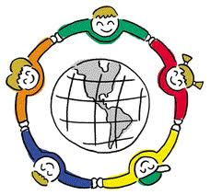
Global Citizenship
Ground Rules
What is a global citizen and what does a good global citizen do?
Oxfam sees a global citizen as someone who:
Is aware of the wider world and has a sense of their own role as a world citizen
Respects and values diversity
Has an understanding of how the world works economically, politically, socially, culturally, technologically and environmentally
Is outraged by social injustice
Participates in and contributes to the community at a range of levels from local to global
Is willing to act to make the world a more sustainable place
Takes responsibility for their actions

Slide 3
Global Citizenship
Ground Rules
Read the article about the Genocide in Rwanda
Consider the following questions:
Are you bothered about what happened in Rwanda? Why?
Is there anything you can do to help prevent this sort of thing from happening?
Do you feel responsible in any way to do something about such issues?
http://www.bbc.co.uk/news/world-africa-13431486

Slide 4
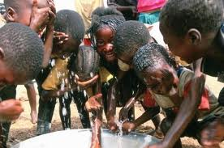
Global Citizenship
Ground Rules
Consider the following scenarios and discuss with the person next to you how you would react to them:
You see a WaterAid advert that asks for £2 a month to help people in Sub-Saharan Africa

Slide 5
Global Citizenship
Ground Rules
Consider the following scenarios and discuss with the person next to you how you would react to them:
You hear someone making openly racist remarks on a tube

Slide 6
Global Citizenship
Ground Rules
Consider the following scenarios and discuss with the person next to you how you would react to them:
Amnesty international reports that a woman in Sudan is set to be executed for refusing to convert to Islam

Slide 7
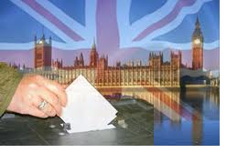
Global Citizenship
Ground Rules
Consider the following scenarios and discuss with the person next to you how you would react to them:
A general election is approaching and you don’t know who to vote for

Slide 8
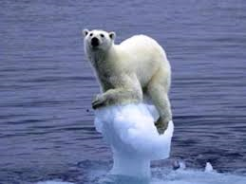
Global Citizenship
Ground Rules
Consider the following scenarios and discuss with the person next to you how you would react to them:
A global warming report states that the continued burning of fossil fuels will lead to the loss of all Arctic ice within the next 50 years

Slide 9
Global Citizenship
Ground Rules
When considering our role as Global Citizens we should always

Slide 10
Global Citizenship
Ground Rules
How does the scenario you studied link to the aims of the lesson?
Aims
-To consider what it means to be a global citizen
-To consider why our actions and responsibilities are increasingly global
-To consider what might happen if we do not think globally

Slide 11
Global Citizenship
Ground Rules
Tweet of the Day:
……………………………………………………………………………………………………………………………………………………………………………………………………………………………………………………………………………………………………………………

Slide 12
Chosen Scenario:…………………………………………………………………………………
What you know about the situation:
………………………………………………………………………………………………………………………………………………………………………………………………………………………………………………………………………………………………………………………………………
What is causing the issue:
…………………………………………………………………………………………………………………………………………………………………………………………………………………………
What are the consequences of the issue:
…………………………………………………………………………………………………………………………………………………………………………………………………………………….....
How might different people have differing views of the issue:
………………………………………………………………………………………………………………………………………………………………………………………………………………………………………………………………………………………………………………………………………
Where could you find out more information:
……………………………………………………………………………………………………………
What could be done about this issue on a variety of scales:
Locally:………………………………………………………………………………………………………………………………………………………………………………………………………………
Nationally:………………………………………………………………………………………………………………………………………………………………………………………………………….
Internationally:……………………………………………………………………………………………………………………………………………………………………………………………………
What impact might your actions have:
………………………………………………………………………………………………………………………………………………………………………………………………………………………
What obstacles might be in your way:
…………………………………………………………………………………………………………………………………………………………………………………………………………….…………..
What might be the consequences of doing nothing:
………………………………………………………………………………………………………………………………………………………………………………………………………………………..
Chosen Scenario:…………………………………………………………………………………
What you know about the situation:
………………………………………………………………………………………………………………………………………………………………………………………………………………………………………………………………………………………………………………………………………
What is causing the issue:
…………………………………………………………………………………………………………………………………………………………………………………………………………………………
What are the consequences of the issue:
…………………………………………………………………………………………………………………………………………………………………………………………………………………….....
How might different people have differing views of the issue:
………………………………………………………………………………………………………………………………………………………………………………………………………………………………………………………………………………………………………………………………………
Where could you find out more information:
……………………………………………………………………………………………………………
What could be done about this issue on a variety of scales:
Locally:………………………………………………………………………………………………………………………………………………………………………………………………………………
Nationally:………………………………………………………………………………………………………………………………………………………………………………………………………….
Internationally:……………………………………………………………………………………………………………………………………………………………………………………………………
What impact might your actions have:
………………………………………………………………………………………………………………………………………………………………………………………………………………………
What obstacles might be in your way:
…………………………………………………………………………………………………………………………………………………………………………………………………………….…………..
What might be the consequences of doing nothing:
………………………………………………………………………………………………………………………………………………………………………………………………………………………..

Slide 13
Aims
-To consider what it means to be a global citizen
-To consider why our actions and responsibilities are increasingly global
-To consider what might happen if we do not think globally
Time | Task
10 mins | Students discuss in pairs what they believe global citizen is/does. Reveal the Oxfam definition of a global citizen. Discuss each of the individual points briefly
10 mins | Students read the article on Rwandan Genocide. Discuss the questions on the slide with the students
10 mins | Students consider the different scenarios on the board and discuss how they would react to each one. Discuss each one with the class
5 mins | Explain the concept of Learn-Think-Act
15 mins | Students pick one of the scenarios from the board and complete the worksheet provided. Discuss students’ responses as a class Diff: May choose to give some of the more well known scenarios (global warming) to the less able and vica versa
5 mins | Tweet of the day: Students write a tweet (no more than 140 characters, in their books) to summarise the lesson. This could be a key fact or question from the lesson

