Slide 1
Ground Rules
http://www.bbc.co.uk/news/business-25947984

Slide 2
Ground Rules
Ethical Consumerism
Aims:
-To understand a variety of consequences of our purchasing habits
-To identify how making informed choices can influence our world

Slide 3
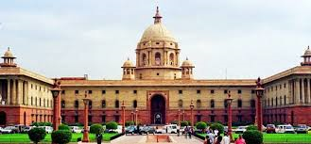
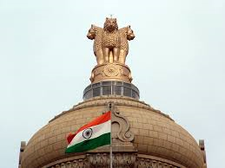
Ground Rules
Discuss how each of the following could be responsible for child labour
The Indian Government

Slide 4
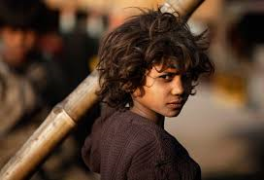
Ethical Consumerism
Ground Rules
Discuss how each of the following could be responsible for child labour
The Child Workers

Slide 5
Ethical Consumerism
Ground Rules
Discuss how each of the following could be responsible for child labour
The Companies that Order the Products

Slide 6
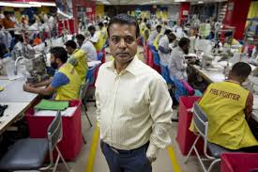
Ethical Consumerism
Ground Rules
Discuss how each of the following could be responsible for child labour
The Owner of the factory

Slide 7
Ethical Consumerism
Ground Rules
Discuss how each of the following could be responsible for child labour
Western Consumers

Slide 8
Ethical Consumerism
Ground Rules
 | Should the government monitor factories more closely? Is this a realistic possibility? Does the profit earned from child labour help the country as a whole through increased GDP and greater tax budget?
 | Does the child not have free will? Are they making a choice to work? What is there alternative? Could they realistically get an education and do something better?
 | Does the TNC have responsibility over the factories it subcontracts production to? Does it have a moral duty to check how its products are made?
 | Is the factory owner forced to employ children because the TNC’s demands are too high? Is employing children better than having no work for anybody because they can’t compete with other factories’ prices?
 | Do we have a responsibility to know where our products come from? Is our increasing demand for cheaper products forcing TNCs to move production to potentially illegitimate suppliers?

Slide 9
Ethical Consumerism
Ground Rules
Class vote:
Who is most responsible for the presence of child labour in India?

Slide 10
Ethical Consumerism
Ground Rules
Class vote:
Who holds the greatest power to reduce child labour in India?

Slide 11
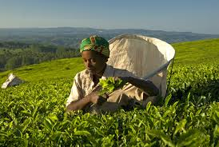
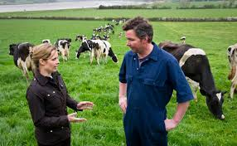
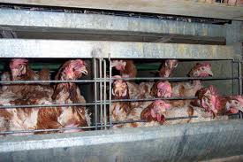
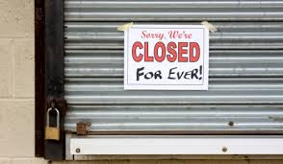
Ethical Consumerism
Ground Rules
Poor working conditions
Low prices for British farmers
Other issues sustained by consumerism
Cruelty to animals
Loss of small, local businesses
Zero hours contracts and lack of a ‘living wage’

Slide 12
Ethical Consumerism
Ground Rules
Poor working conditions
Low prices for British farmers
Other issues sustained by consumerism
You are to create a 2 minute presentation for the class which outlines:
What the problem is (detail)
The players that are responsible (range of explanations)
How the problem can be reduced (may have a specific strategy)
Cruelty to animals
Loss of small, local businesses
Zero hours contracts and lack of a ‘living wage’

Slide 13
CVs
Sex and Contraception
Tweet of the Day:
……………………………………………………………………………………………………………………………………………………………………………………………………………………………………………………………………………………………………………………

