Slide 1
What do all of below have in common?
Postivity

Slide 2
http://www.bbc.co.uk/news/uk-33155853
"I thought it was never going to end. I just wanted to die."
In groups, discuss how you would have reacted?

Slide 3
Positivity
Aims:
-To understand the impact of ‘positivity and appreciation’.
-To identify how making informed choices can influence our world

Slide 4
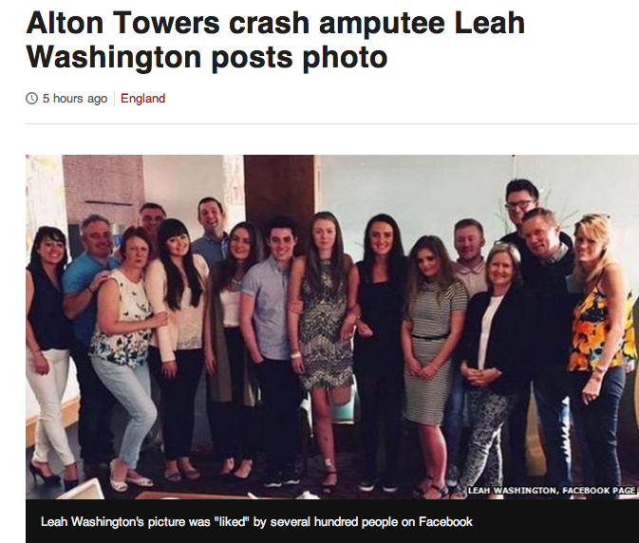

Slide 5
What is your perspective of life?
What are you grateful for?
What would you change if you could?
Discuss: 5mins

Slide 6
Think of a comment that may have effected your confidence? What was said? How did you feel?
Discuss: 5mins

Slide 7
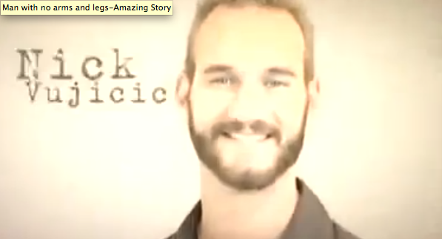
Man with no arms and legs-Amazing Story
https://www.youtube.com/watch?v=GSayMXTaQY8

Slide 8
What is the message Nick is trying to get across?
What stops you at times from being positive?

Slide 9
“Be thankful, think big and achieve your dreams?”
What are your dreams? What would you want to change if you could?

Slide 10
Task- You have 15 minutes
Plan out what you want to achieve in the short to medium term? Break this down;
Achieve this summer
Achieve within the next year
Achieve within the next 5 years.
You will present your plan to the group

Slide 11
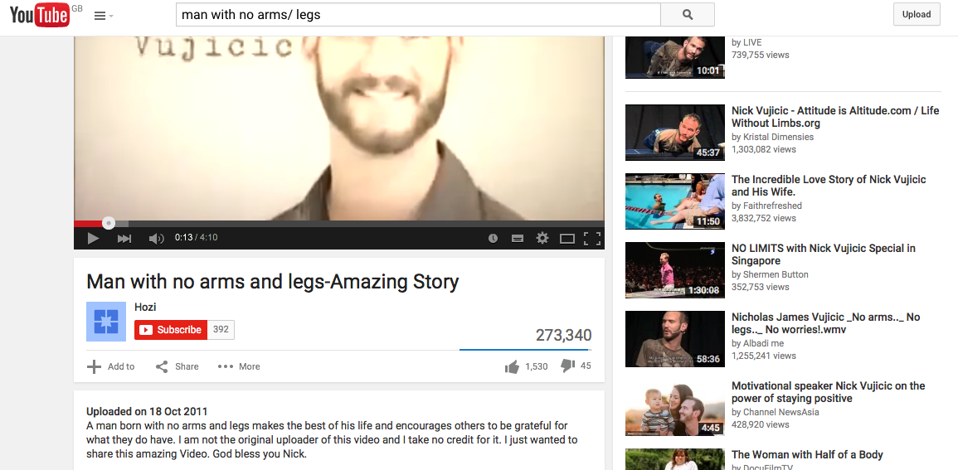
Plenary
In groups, allow the group to choose a video that they wish to watch on ‘Positivity’. Use your discretion.

